Slide 1
Chapter 12
Field-Effect Transistors
場效電晶體

Slide 2
Field-Effect Transistors (FETs)
FET (場效電晶體) 是利用電場來控制電流的大小，而且組成電流的載子僅限一種極性，即電洞或是自由電子 。
Metal-Oxide-Semiconductor Field-Effect Transistor (MOSFET,金氧半場效電晶體）可分為NMOS (以電子為電流載子)與PMOS(以電洞為電流載子) 。
MOSFET 包含source (源極)、gate (閘極)、drain(汲極)及body(基座) 。

Slide 3
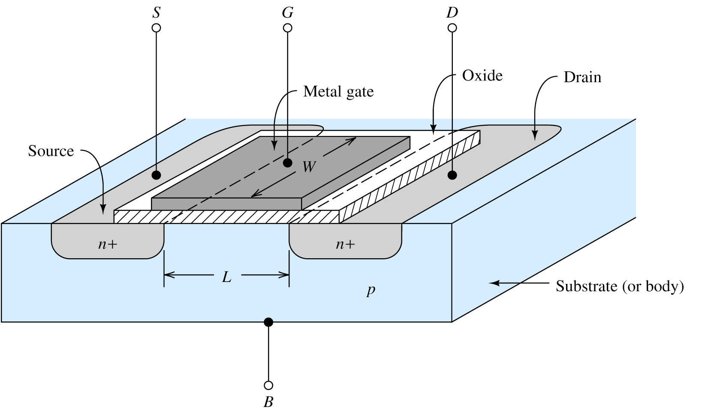
12.1 NMOS AND PMOS TRANSISTORS
NMOS Transistor (n-p-n)
氧化物為絕緣體，沒有電
流能進入閘極端；
控制閘極電壓能夠調整
汲極到源極的電流
(gate 閘極)
(drain 汲極)
(source 源極)
(O, 氧)
(M, 金)
場效
(S, 半)
(Body 基板)

Slide 4
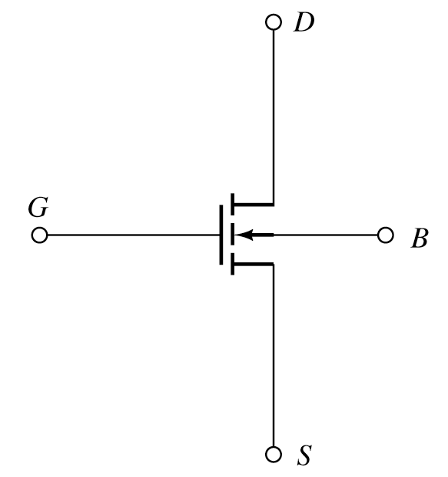
NMOS (n-channel MOS)
NMOS 之 source (源極)與drain(汲極)為n-type 半導體， body(基座) 為p-type 半導體， gate (閘極)為導體 。
n-p-n

Slide 5
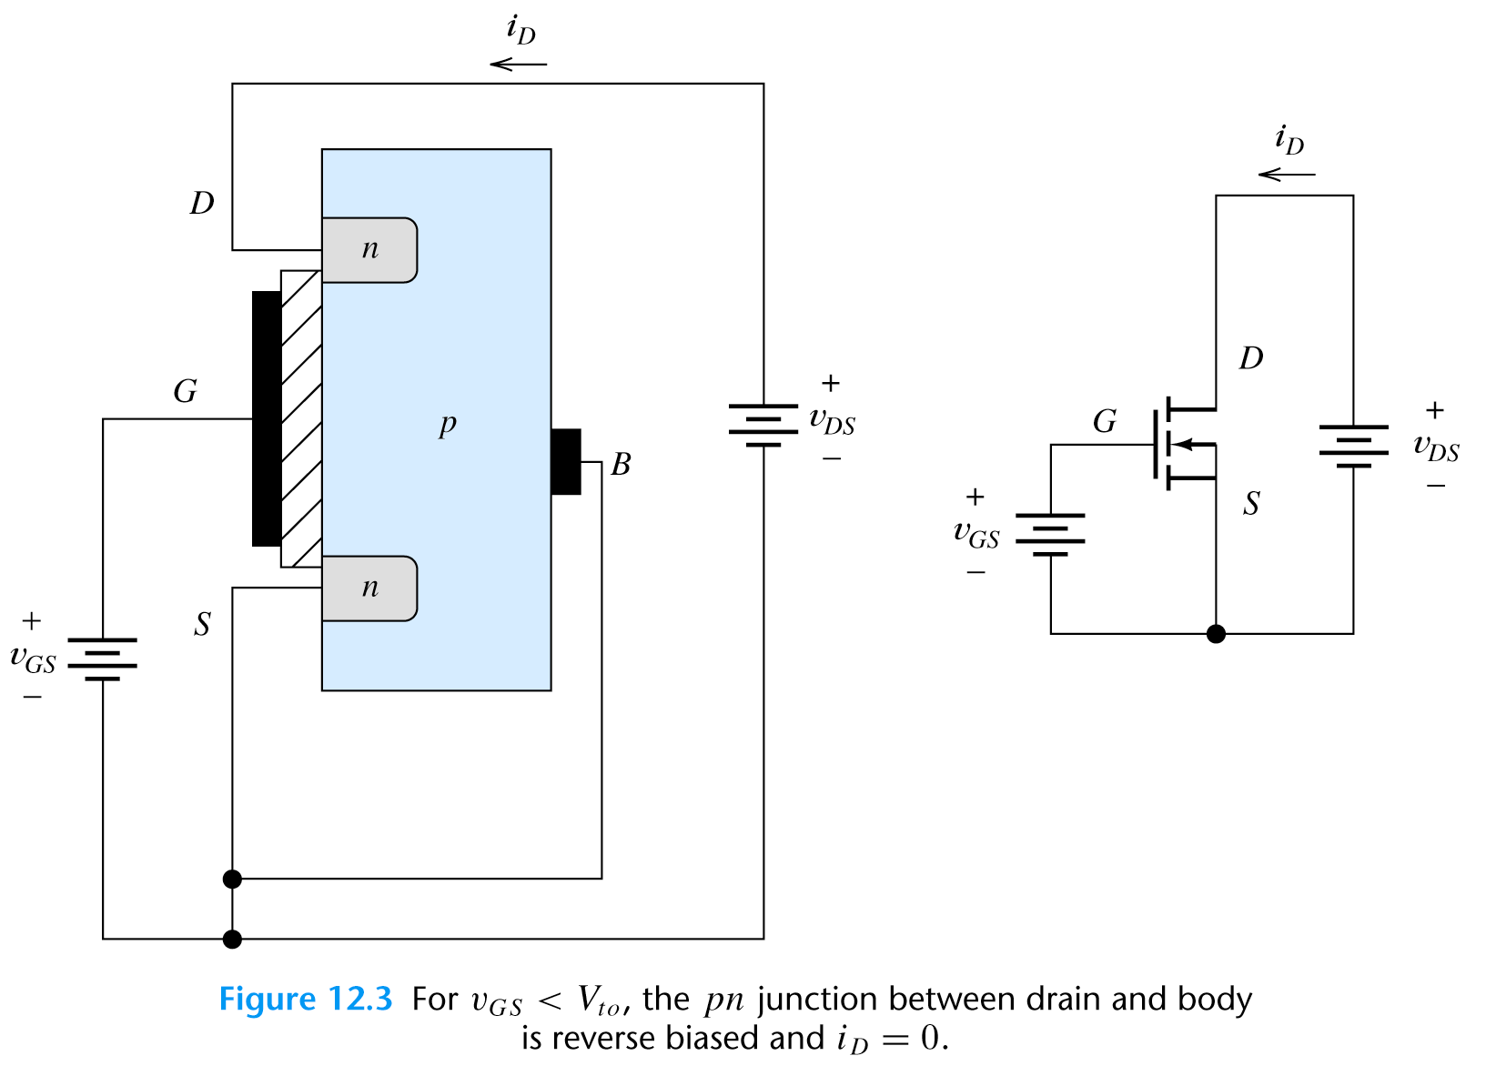

Slide 6
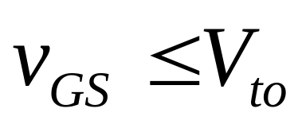
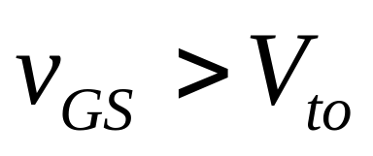
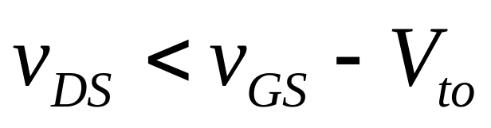
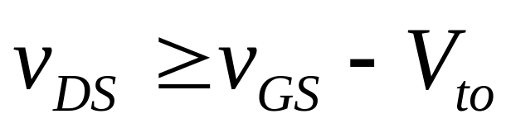
NMOS 的運作 (Operation)
NMOS 的運作可分為三區(region)
  Cutoff Region (截止區)
  Triode Region (三極區) or Linear Region (線性區)
  Saturation Region (飽合區)
and
and

Slide 7


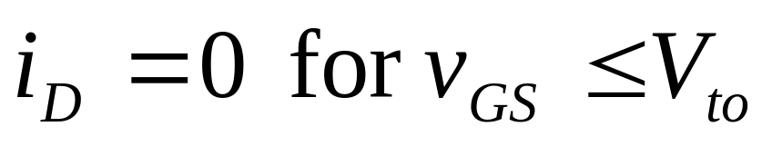
Operation in the Cutoff Region
當閘極(gate)與源極(source)間電壓v_{GS} =0，兩個pn接面(body-source) 與(body-drain)可視為兩個方向相反的二極體，此時MOSFET為截止(cutoff)。
當閘極(gate)與源極(source)間電壓v_{GS} 逐漸上升到>V_{to} (threshold voltage,臨限電壓)時，則NMOS才會開始導通。

Slide 8
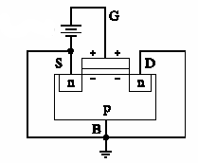
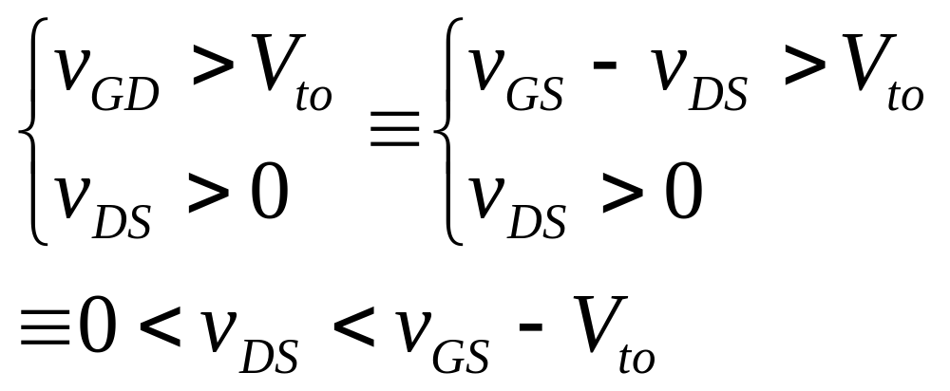
Operation in the Triode Region
and
當閘極(gate)帶正電時，可逐漸吸引自由電子聚集在絕緣層的下方， 並將電洞推離絕緣層下方。

Slide 9
Operation in the Triode Region
and
當閘極(gate)與源極(source)間電壓v_{GS} 逐漸上升到>V_{to} (threshold voltage,臨限電壓)，且在drain和source之間加有電壓v_{DS}，則形成n-type通道(channel)，通道中的自由電子受到外加電場的驅動，形成汲極電流(drain current)i_{D}，其方向從drain流向source，和通道中的電子流方向相反。
當v_{DS}很小時， i_{D}與v_{DS}成正比， 亦與v_{GS} - V_{to}成正比。
由於有氧化絕緣層，故閘極電流 i_{G} ＝ 0。

Slide 10
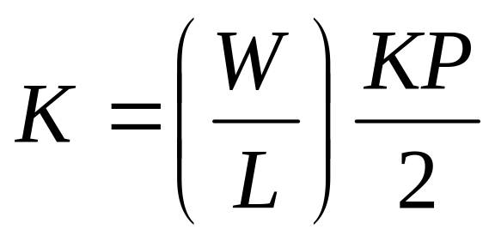
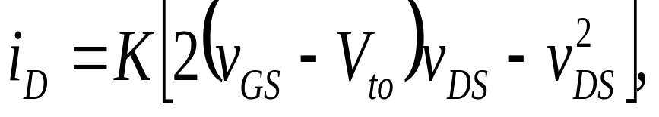
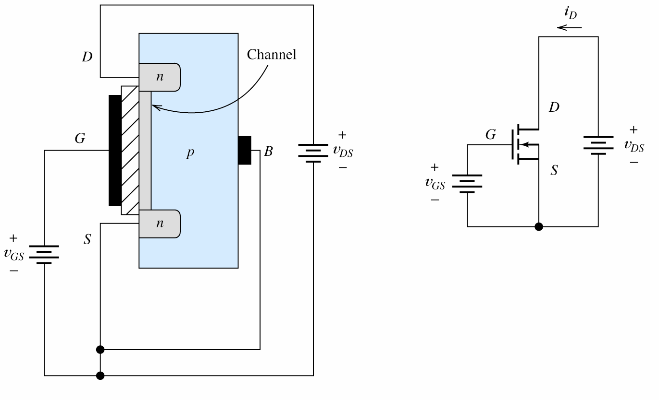
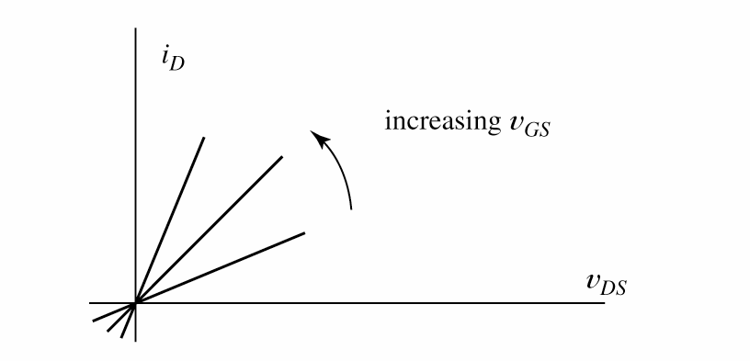
Operation in the Triode Region
In the triode region, the NMOS behaves as a resistor connected between drain and source, but the resistance decreases as v_{GS} increases.
0, if v_{DS}~0
Device parameter

Slide 11
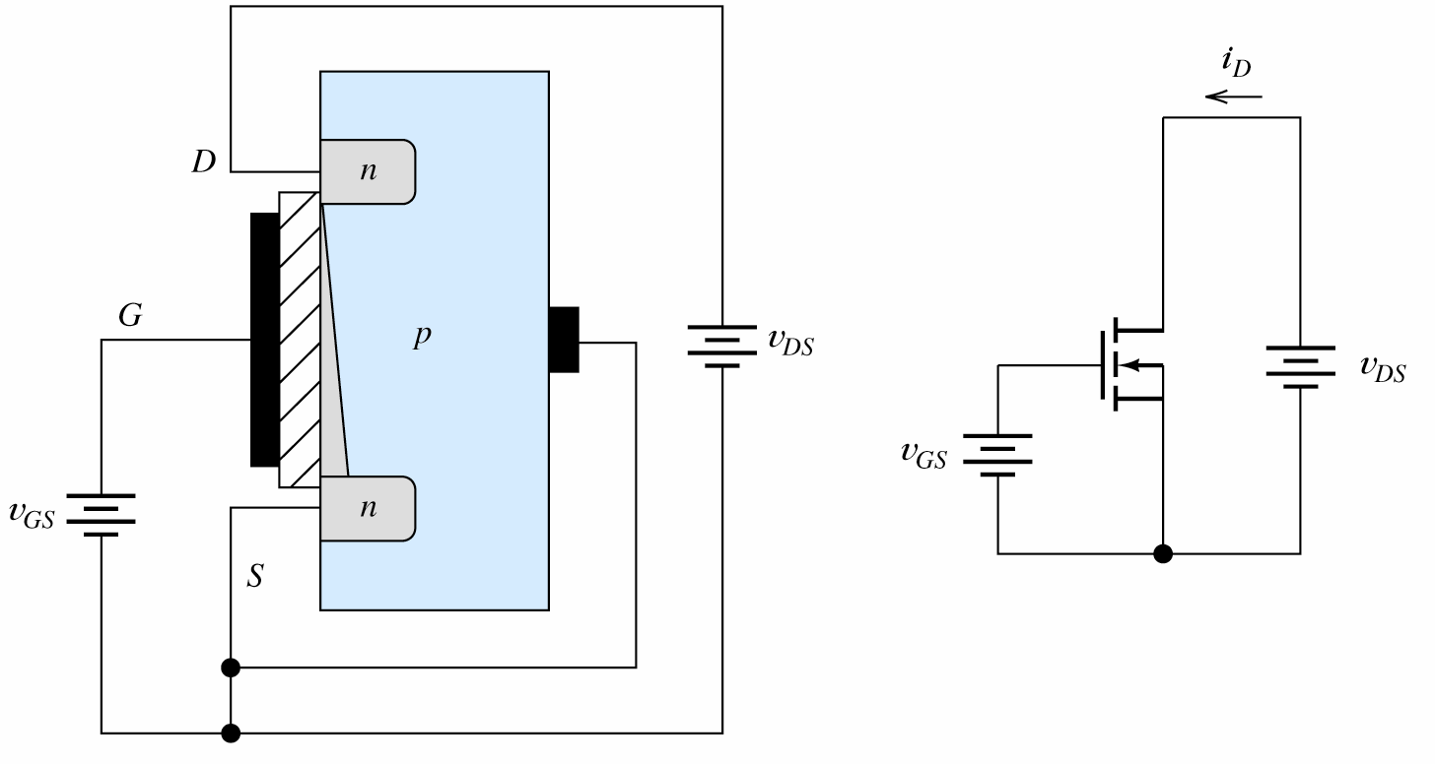
Operation in the Saturation Region
and
當drain和source之間電壓v_{DS}≥ v_{GS} - V_{to}(or v_{GD}≤ V_{to}) 則n-type通道在drain端寬度變為0 ，v_{DS}再變大， i_{D}不再上升， 稱為飽合區。

Slide 12
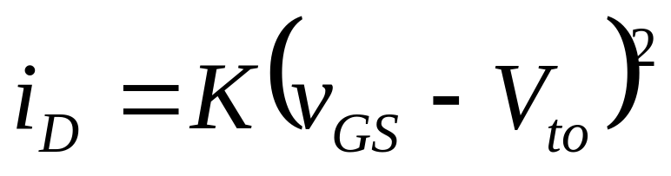
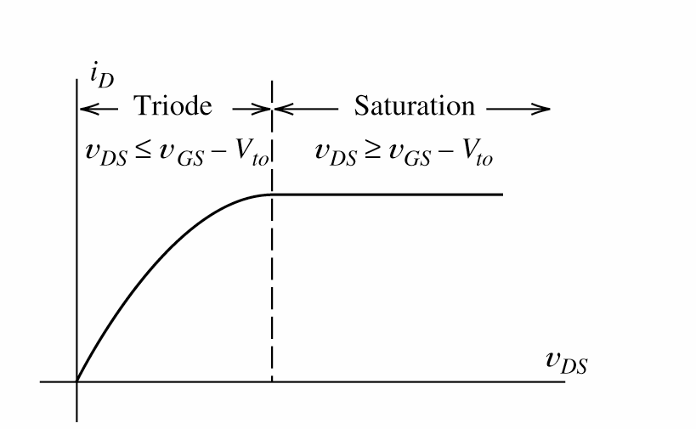
Operation in the Saturation Region

Slide 13
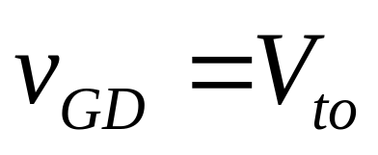
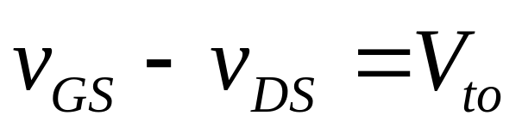
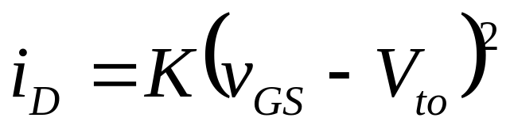
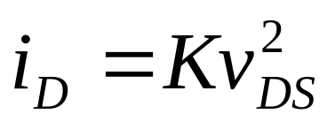
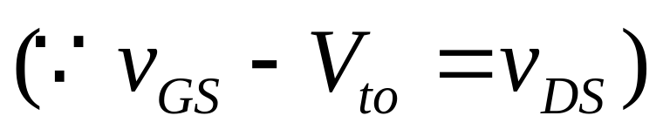
Boundary between Triode and Saturation Regions
At boundary, 使得n-type通道在drain端寬度剛好為0
代入I-V equation in saturation region

Slide 14
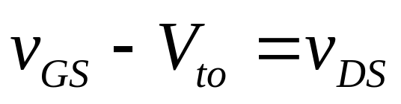
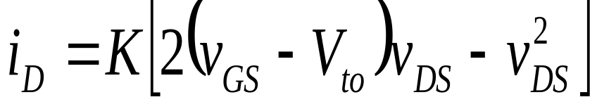
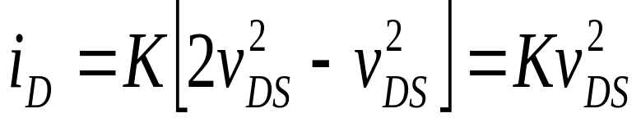
Boundary between Triode and Saturation Regions
將 代入I-V equation in triode region
兩者結果一樣。

Slide 15
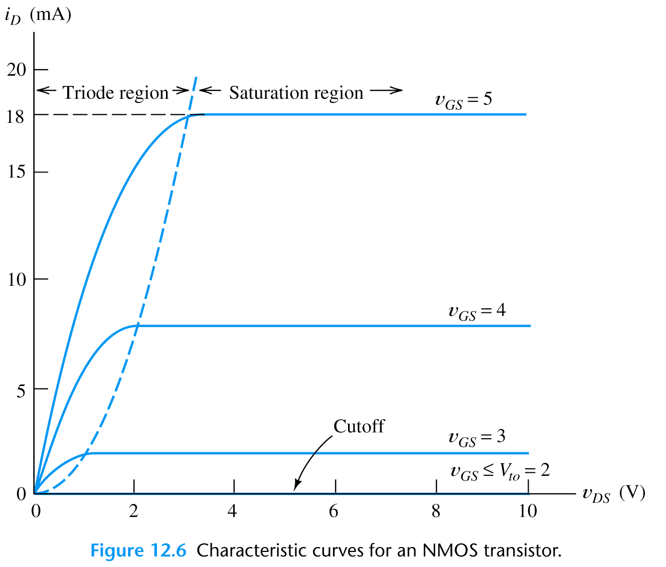
boundary

Slide 16
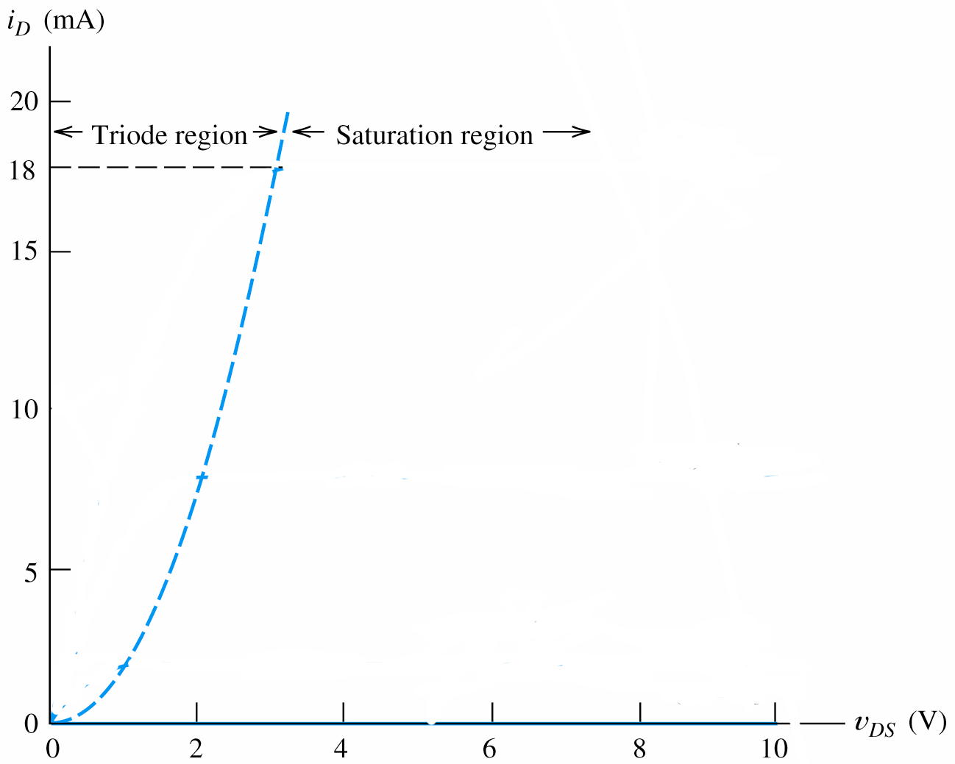
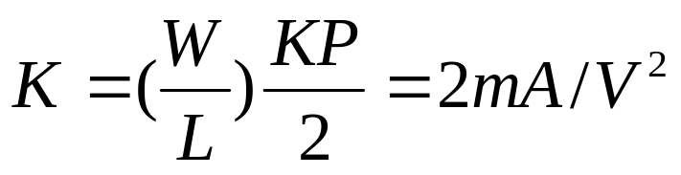
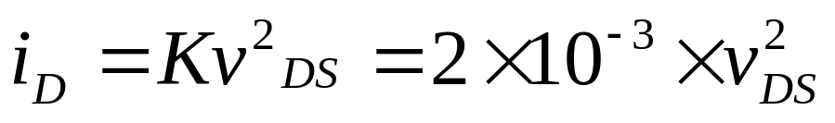
Example 12.1
A NMOS transistor W=160um, L=2um, KP=50uA/V², and V_{to}=2 V. Plot the drain characteristic curves to scale for v_{GS}=0, 1,2, 3, 4, and 5 V.
1. 求 K
2. 求 boundary

Slide 17
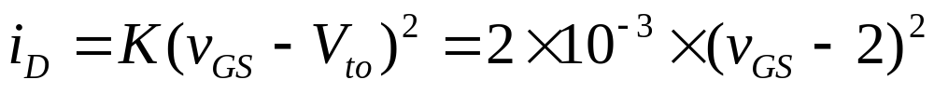
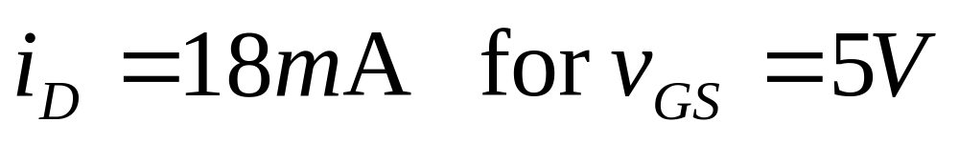
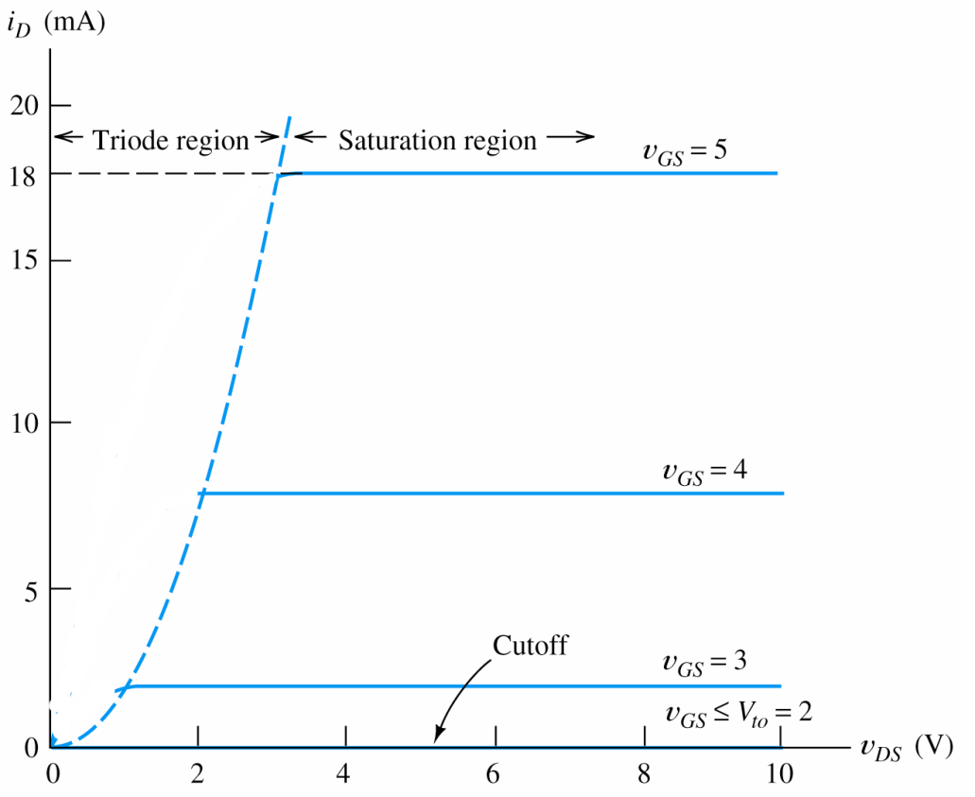
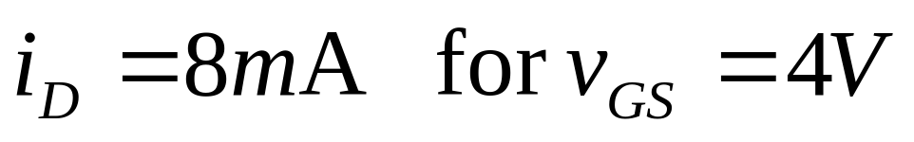
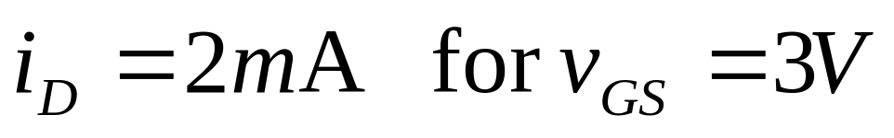
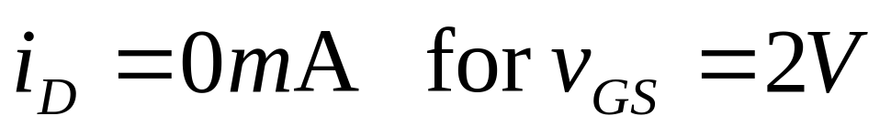
3. 求 saturation currents

Slide 18
4. Plot characteristics in the triode region (parabola 拋物線).

Slide 19
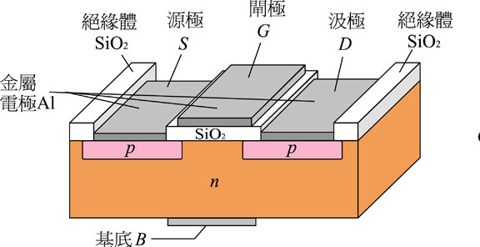
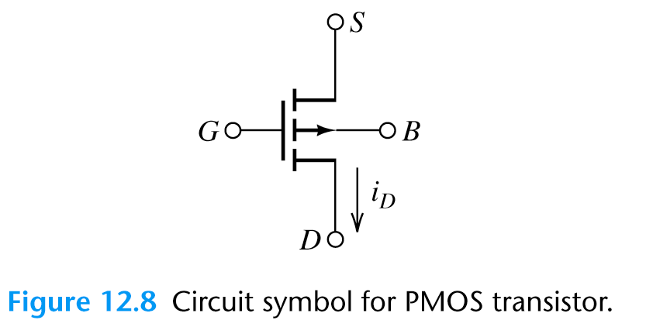
PMOS
PMOS 之 source 與drain為p-type 半導體， body為n-type 半導體， gate (閘極)為導體 。
以電洞為電流載子。

Slide 20
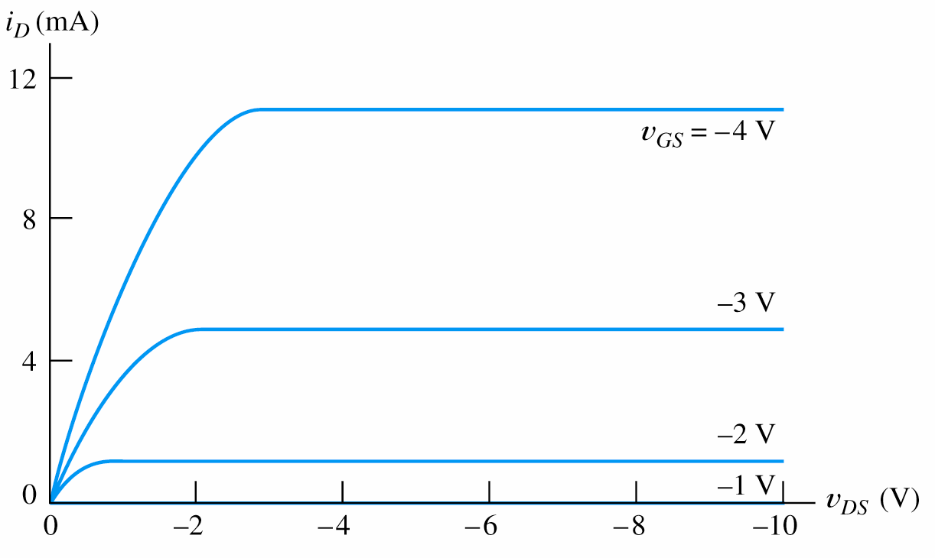

Slide 21
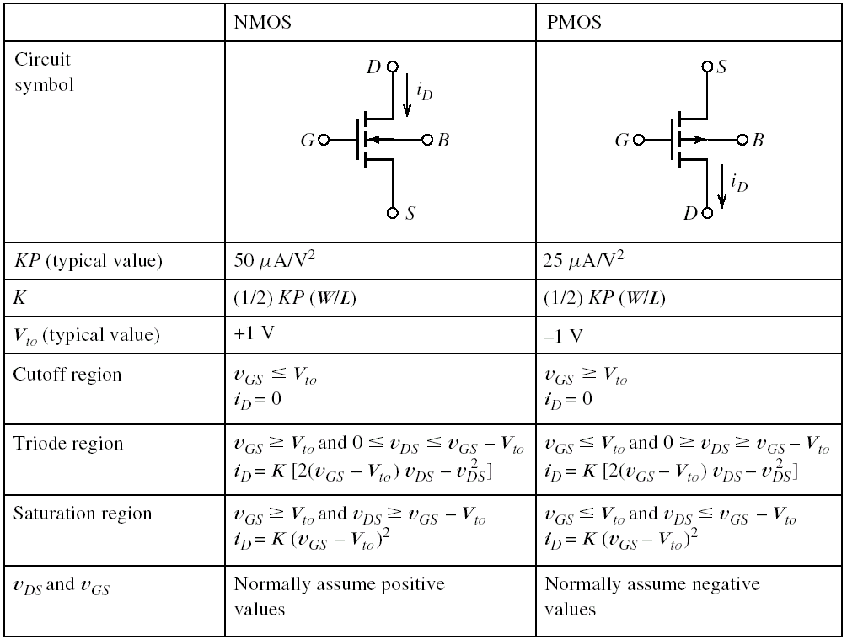
MOSFET Summary

Slide 22
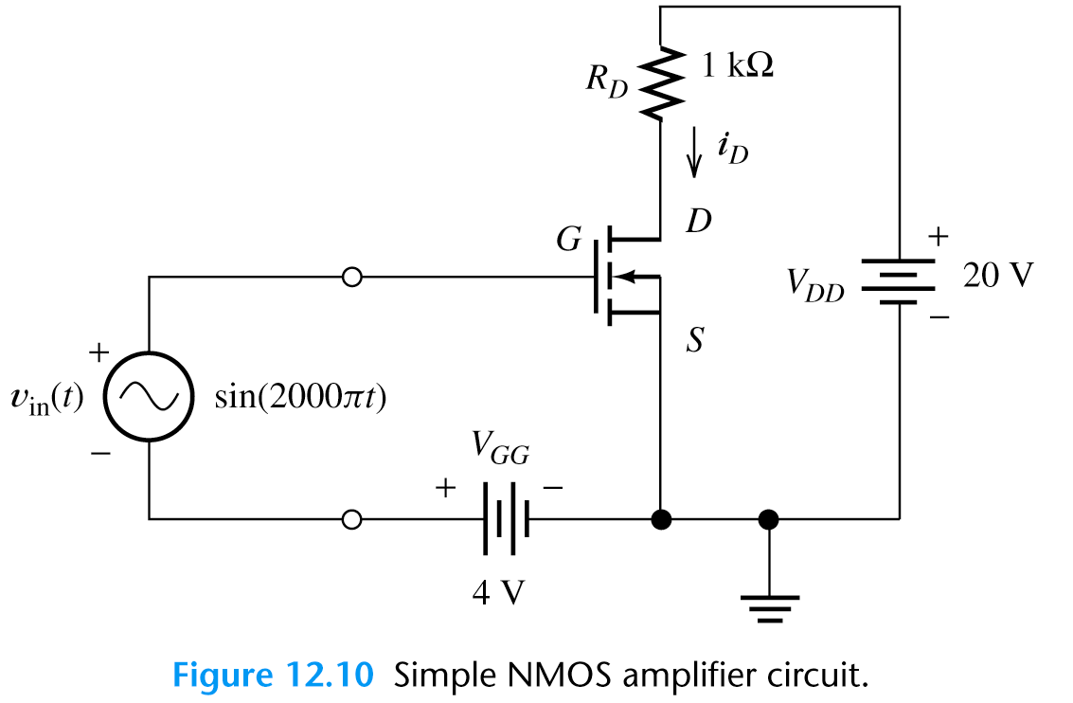
12.2 LOAD-LINE ANALYSIS OF A SIMPLE NMOS AMPLIFIER

Slide 23
12.2 LOAD-LINE ANALYSIS OF A SIMPLE NMOS AMPLIFIER
V_{GG} (dc source) 對NMOS 產生偏壓(bias) ，決定操作點， 當ac input 在操作點附近隨時間變化，導致v_{GS}, i_{D}亦隨時間改變。

Slide 24
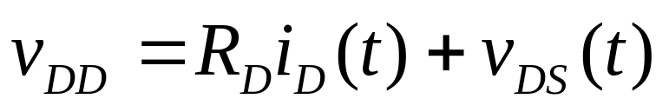
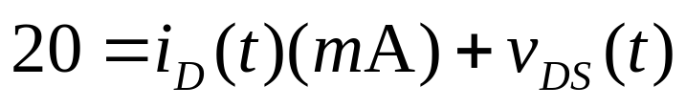
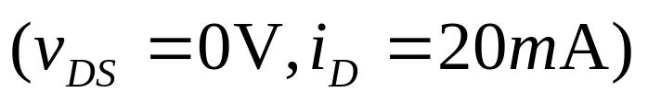
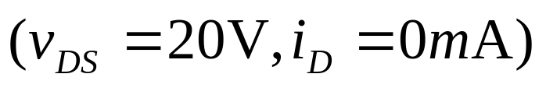
i_{D}隨時間改變，導致R_{D}亦上的壓降隨時間改變， 使得v_{DS}產生 ac output。
KVL
Load-line equation
Load-line 兩端點

Slide 25
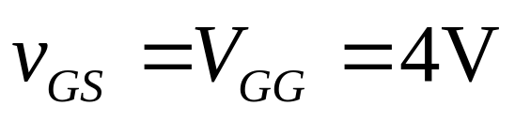
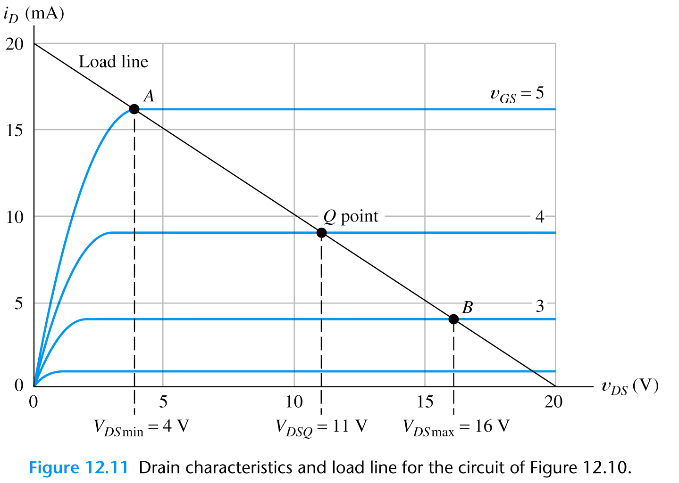
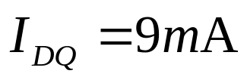
Quiescent operation point (Q point) is at v_{in}=0.

Slide 26
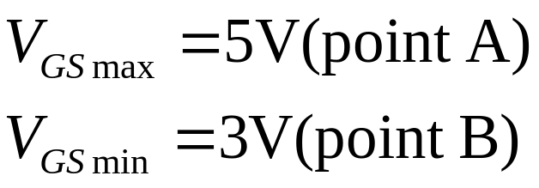

Slide 27
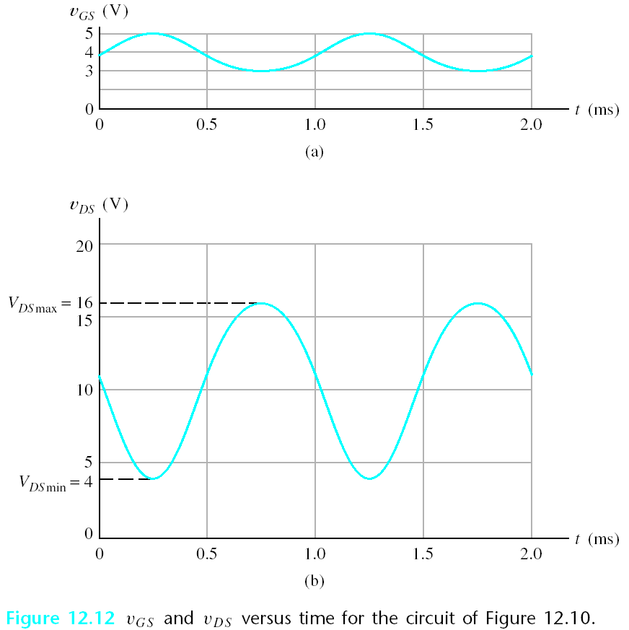
1 V
V_{GSQ}=4
5 V
V_{DQ}=11
7 V
Distortion (變形)

Slide 28
Distortion
Distortion is due to that the characteristic curves for the FET are not uniformly spaced.
If a much smaller input amplitude was applied we would have amplification without appreciable distortion.

Slide 29
Amplifier Analysis
12.3 Bias Circuits
Amplifier analysis has two steps:
1. Determine the Q point.
2. Use a small-signal equivalent circuit to determine impedances and gains.

Slide 30
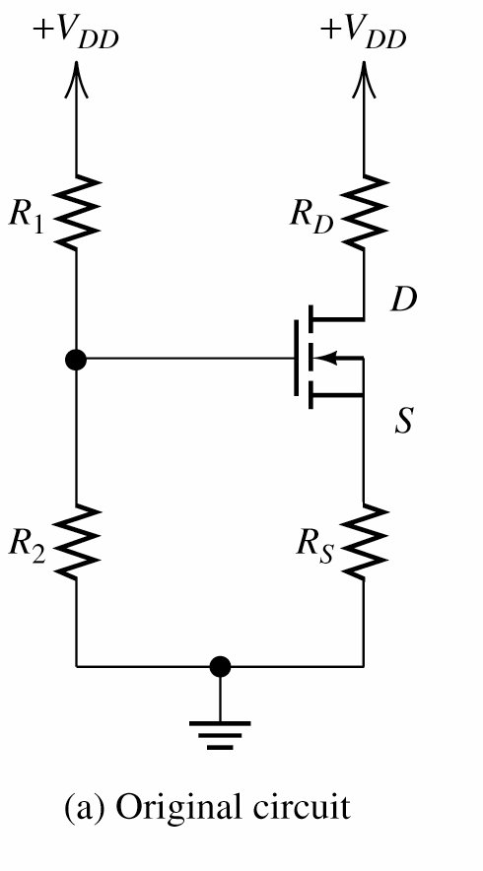


The Fixed- Plus Self-Bias Circuit

Slide 31



The Fixed- Plus Self-Bias Circuit
1. Thévenin equivalent

Slide 32





2. KVL
3. Usually, transistor operates in saturation region

Slide 33



4. Load Line Analysis i_{D} vs. v_{GS}

Slide 34

5. Determine v_{DS}

Slide 35



Example 12.2
Analyze the following circuit. The transistor KP=50uA/V², V_{to}=2 V, L=10um, W=400um
1. Determine K
2. Thévenin equivalent

Slide 36






3. Determine V_{GSQ}
×

Slide 37


4. I_{DQ} & V_{DSQ}

Slide 38





12.4 SMALL-SIGNAL EQUIVALENT CIRCUITS
Small signal (ac)
Small signal (ac)
To determine v_{gs}(t) vs. i_{d}(t)

Slide 39





SMALL-SIGNAL EQUIVALENT CIRCUITS
At Q point
0

